Slide 1
ECE408 / CS483 Fall 2016 Applied Parallel Programming Lecture 1: Introduction

Slide 2
Course Goals
Learn to program massively parallel processors and achieve
high performance
functionality and maintainability
scalability across future generations
Technical subjects
principles and patterns of parallel algorithms
processor architecture features and constraints
programming API, tools and techniques

Slide 3
People
Instructor:
Prof Wen-mei Hwu
215 CSL, w-hwu@illinois.edu, 244-8270
use ECE408 to start your e-mail subject line
Office hours: 2-3pm Tuesdays; or by appointment
Teaching Assistants:
Cheng Li, Sharon Tang, and Wan Chen
Office hours: Check the course website

Slide 4
Brief Bio of Wen-mei Hwu
Ph.D. from University of California, 1987
Research: Computer Architecture and Parallel Computing
Professor of ECE since 1987
Chief Scientist of Parallel Computing Institute, Co-PI Blue Waters
Director of several research centers, most recently IBM C3SR
CTO and co-founder MulticoreWare
Advisor and Board Member to 8 startups to date
Researcher, teacher, author, technologist, and entrepreneur

Slide 5
How we will run the course Fall 2016
Lecture Video for each major topical segment is on-line.
Your responsibility is to absorb BEFORE corresponding lecture
Lectures by me when I am in town.
Flipped classroom by Carl Pearson when I am traveling – discuss finer points, answer questions, work through problems.

Slide 6
Web Resources
Website: https://wiki.cites.illinois.edu/wiki/display/ece408f16
login to see the home page
Handouts and lecture slides/recordings
Textbook chapters, documentation, software resources
Note: While we’ll make an effort to post announcements on the web, we can’t guarantee it, and won’t make any allowances for people who miss things in class.
Web board discussions in Piazza
Channel for electronic announcements
Forum for Q&A - the TAs and Professors read the board, and your classmates often have answers
Compass - grades

Slide 7
Grading
Exams: 35%
Exam 1: 15%
Exam 2: 20%
Labs (Machine Problems): 35%
Passing Datasets 70%
Questions 30%
Project: 30%
Automatic Demo/Functionality: 50%
Final Report: 30%
Automatic Performance Ranking with full functionality: 20%

Slide 8
Academic Honesty
You are allowed and encouraged to discuss assignments with other students in the class. Getting verbal advice/help from people who’ve already taken the course is also fine.
Any reference to assignments from previous terms or web postings is unacceptable
Any copying of non-trivial code is unacceptable
Non-trivial = more than a line or so
Includes reading someone else’s code and then going off to write your own.

Slide 9
Academic Honesty (cont.)
Giving/receiving help on an exam is unacceptable
Penalties for academic dishonesty:
Zero on the assignment for the first occasion
Automatic failure of the course for repeat offenses

Slide 10
Competition Team Project
Work can be divided up between team members in any way that works for you
However, each team member need to be on top of the project and may get a separate grade

Slide 11
Text/Notes
D. Kirk and W. Hwu, “Programming Massively Parallel Processors – A Hands-on Approach,” Morgan Kaufman Publisher, 2nd edition, 2012, ISBN 978-0123814722
We will be using a pre-production version of the 3rd Edition, all chapters are in Wiki
NVIDIA, NVidia CUDA C Programming Guide, version 8.0, NVidia, 2016 (reference book)

Slide 12
Tentative Schedule (Class Schedule Tab in Wiki)
Week 1:
Tu: Lecture 1: Introduction
Th: Lecture 2: CUDA Intro
MP-0, installation, test account
Week 2:
Tu: Lecture 3: Data Parallelism Model (Flipped)
Th: Lecture 4: Data Parallelism Model
MP-1, vector addition
Week 3:
Tu: Lecture 5: CUDA Memory Model
Th: Lecture 6: CUDA Memory Model
MP-2, simple matrix multiplication

Slide 13
A major paradigm shift
In the 20th Century, we were able to understand, design, and manufacture what we can measure
Physical instruments and computing systems allowed us to see farther, capture more, communicate better, understand natural processes, control artificial processes…

Slide 14
A major paradigm shift
In the 21st Century, we are able to understand, design, and create what we can compute
Computational models are allowing us to see even farther, going back and forth in time, learn better, test hypothesis that cannot be verified any other way, create safe artificial processes…

Slide 15
Examples of Paradigm Shift
20th Century
Small mask patterns
Electronic microscope and Crystallography with computational image processing
Anatomic imaging with computational image processing
Teleconference
GPS
21st Century
Optical proximity correction
Computational microscope with initial conditions from Crystallography
Metabolic imaging sees disease before visible anatomic change
Tele-emersion
Self-driving cars

Slide 16
Diving deeper into computational microscope
Large clusters (scale out) allow simulation of biological systems of realistic space dimensions
0.5Å (0.05 nm) lattice spacing needed for accuracy
Interesting biological systems have dimensions of mm or larger
Thousands of nodes are required to hold and update all the grid points.
Fast nodes (scale up) allow simulation at realistic time scales
Simulation time steps at femtosecond (10⁻¹⁵ second) level needed for accuracy
Biological processes take miliseconds or longer
Current molecular dynamics simulations progress at about one day for each 10-100 microseconds of the simulated process.

Slide 17
Blue Waters Science Breakthrough Example
Determination of the structure of the HIV capsid at atomic-level
Collaborative effort of experimental groups at the U. of Pittsburgh and Vanderbilt U., and the Schulten’s computational team at the U. of Illinois.
64-million-atom HIV capsid simulation of the process through which the capsid disassembles, releasing its genetic material
a critical step in understanding HIV infection and finding a target for antiviral drugs.

Slide 18
Post-Dennard technology pivot - heterogeneity

Slide 19
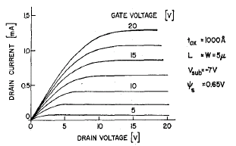
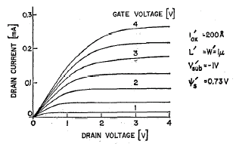
Dennard Scaling of MOS Devices
JSSC Oct 1974, page 256
In this ideal scaling, as L → α*L
V_{DD} → α*V_{DD}, C → α*C, i → α*i
Delay = CV_{DD}/I scales by α, so f → 1/α
Power for each transistor is CV²*f and scales by α²
keeping total power constant for same chip area

Slide 20
Frequency Scaled Too Fast 1993-2003

Slide 21
Total Processor Power Increased (super-scaling of frequency and chip size)

Slide 22
Post-Dennard Pivoting
Multiple cores with more moderate clock frequencies
Heavy use of vector execution
Employ both latency-oriented and throughput-oriented cores
3D packaging for more memory bandwidth

Slide 23
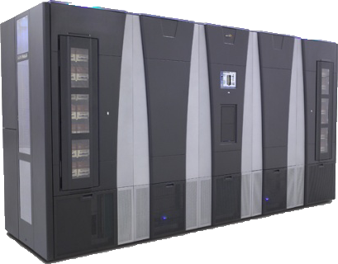
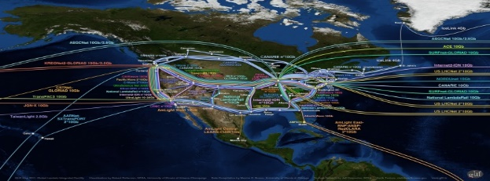
Blue Waters Computing System Operational at Illinois since 3/2013
49,504 CPUs -- 4,224 GPUs
12.5 PF
1.6 PB DRAM
$250M
10/40/100 Gb
Ethernet Switch
IB Switch
>1 TB/sec
120+ Gb/sec
100 GB/sec
WAN
Spectra Logic: 300 PBs
Sonexion: 26 PBs
Notes:
Note just compute – main memory (1.6PB); Disk (26PB); near line (300PB)

Slide 24
Cray XK7 Compute Node
PCIe Gen2
XK7 Compute Node Characteristics
AMD Series 6200 (Interlagos)
NVIDIA Kepler
Host Memory 32GB 1600 MT/s DDR3
NVIDIA Tesla X2090 Memory 6GB GDDR5 capacity
Gemini High Speed Interconnect
Keplers in final installation
HT3
HT3
Z
Y
X

Slide 25
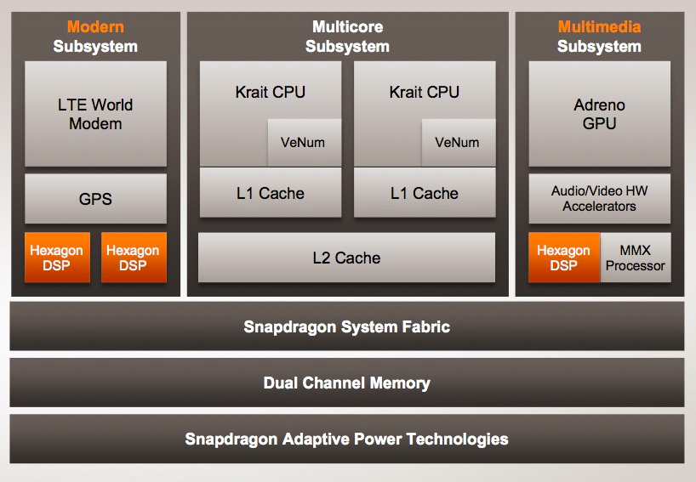
Qualcomm SoC for Mobile

Slide 26
CPUs: Latency Oriented Design
High clock frequency
Large caches
Convert long latency memory accesses to short latency cache accesses
Sophisticated control
Branch prediction for reduced branch latency
Data forwarding for reduced data latency
Powerful ALU
Reduced operation latency
Control
ALU
ALU
ALU
ALU
CPU
Cache
DRAM

Slide 27
GPUs: Throughput Oriented Design
Moderate clock frequency
Small caches
To boost memory throughput
Simple control
No branch prediction
No data forwarding
Energy efficient ALUs
Many, long latency but heavily pipelined for high throughput
Require massive number of threads to tolerate latencies
GPU
DRAM

Slide 28
Applications Benefit from Both CPU and GPU
CPUs for sequential parts where latency matters
CPUs can be 10+X faster than GPUs for sequential code
GPUs for parallel parts where throughput wins
GPUs can be 10+X faster than CPUs for parallel code

Slide 29
Winning Strategies Use Both CPU and GPU
CPUs for sequential parts where latency matters
CPUs can be 10+X faster than GPUs for sequential code
GPUs for parallel parts where throughput wins
GPUs can be 10+X faster than CPUs for parallel code

Slide 30
Heterogeneous parallel computing is catching on.
Financial Analysis
Scientific Simulation
Engineering Simulation
Data Intensive Analytics
Medical Imaging
Digital Audio Processing
Digital Video Processing
Computer Vision
Biomedical Informatics
Electronic Design Automation
Statistical Modeling
Ray Tracing Rendering
Interactive Physics
Numerical Methods
280 submissions to GPU Computing Gems
110 articles included in two volumes

Slide 31
Parallel Programming Work Flow
Identify compute intensive parts of an application
Adopt scalable algorithms
Optimize data arrangements to maximize locality
Performance Tuning
Pay attention to code portability, scalability, and maintainability

Slide 32
Parallelism Scalability

Slide 33
Algorithm Complexity and Data Scalability

Slide 34
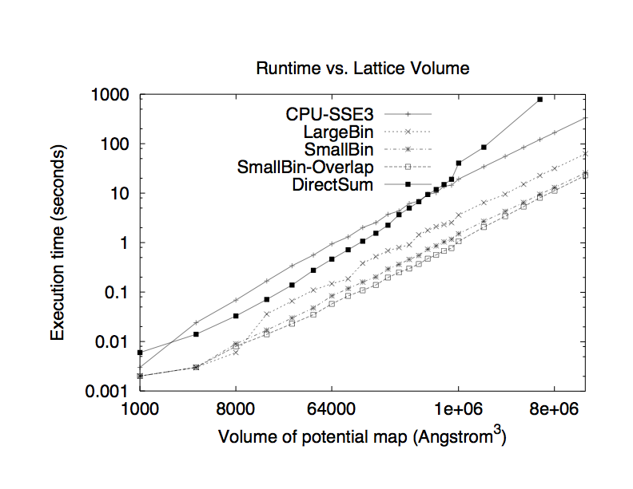
A Real Example of Data Scalability Particle-Mesh Algorithms

Slide 35
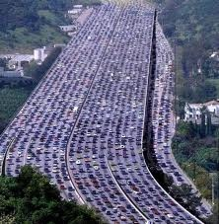
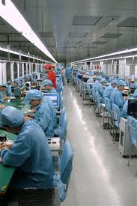
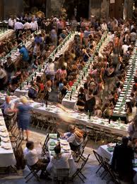
Massive Parallelism - Regularity

Slide 36
Load Balance
The total amount of time to complete a parallel job is limited by the thread that takes the longest to finish
good
bad!

Slide 37
Global Memory Bandwidth
Ideal
Reality

Slide 38
Conflicting Data Accesses Cause Serialization and Delays
Massively parallel execution cannot afford serialization
Contentions in accessing critical data causes serialization

Slide 39
What is the stake?
Scalable and portable software lasts through many hardware generations
Scalable algorithms and libraries can be the best legacy we can leave behind from this era

Slide 40
Any More Questions?

